Slide 1
UNIT IV
Capital Budgeting

Slide 2
Outcome
Appraise the concept of profitability index method and analyze significance of PI in capital budgeting decisions.

Slide 3

News Analysis
https://www.thehindubusinessline.com/markets/stock-markets/longest-bull-run-sensex-closes-in-on-50000-mark/article33560992.ece

Slide 4
Profitability Index/Benefit-Cost Ratio
The Profitability Index (PI) measures the ratio between the present value of future cash flows and the initial investment. The index is a useful tool for ranking investment projects and showing the value created per unit of investment.
The Profitability Index is also known as the Profit Investment Ratio (PIR) or the Value Investment Ratio (VIR) or Benefit cost ratio.

Slide 5
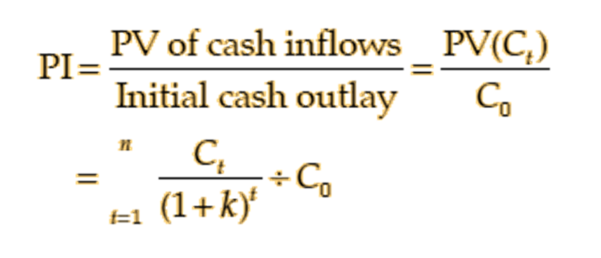
Formula for PI
The formula for calculating benefit-cost ratio or profitability index is as follows:

Slide 6
MCQ
A project's profitability index is equal to the ratio of the………………of a project's future cash flows to the project’s………………...
present value; initial cash outlay
net present value; initial cash outlay
present value; depreciable basis
net present value; depreciable basis

Slide 7
Answer
A. present value; initial cash outlay

Slide 8
Illustration
The initial cash outlay of a project is Rs 100,000 and it can generate cash inflow of Rs 40,000, Rs 30,000, Rs 50,000 and Rs 20,000 in year 1 through 4. Assume a 10 percent rate of discount. Calculate value of profitability index from the above information.

Slide 9
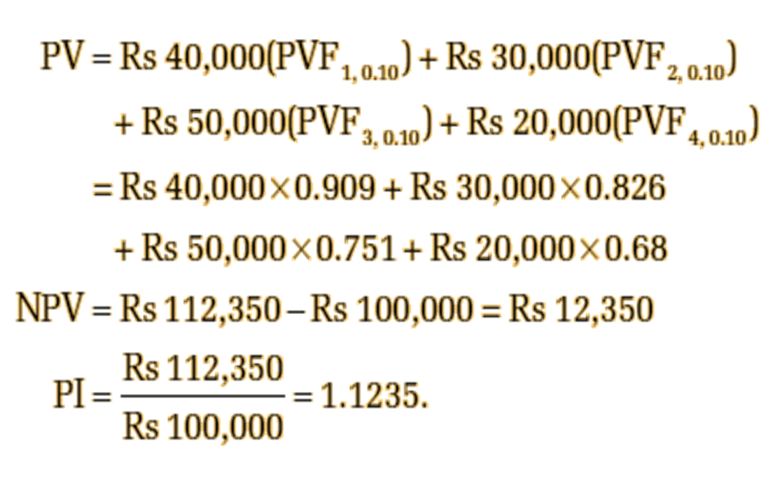
Solution

Slide 10
MCQ
Which of the following statements is incorrect regarding a normal project?
If the NPV of a project is greater than 0, then its PI will exceed 1.
If the IRR of a project is 8%, its NPV, using a discount rate, k, greater than 8%, will be less than 0.
If the PI of a project equals 0, then the project's initial cash outflow equals the PV of its cash flows.
If the IRR of a project is greater than the discount rate, k, then its PI will be greater than 1.

Slide 11
Answer
C. If the PI of a project equals 0, then the project's initial cash outflow equals the PV of its cash flows.

Slide 12
Acceptance Rule
The following are the PI acceptance rules:
  Accept the project when PI is greater than one. PI > 1
  Reject the project when PI is less than one. PI < 1
  May accept the project when PI is equal to one. PI = 1
The project with positive NPV will have PI greater than one. PI less than means that the project’s NPV is negative. The higher the profitability index, the more attractive the investment.

Slide 13
MCQ
A profitability index of .85 for a project means that:
the present value of benefits is 85% greater than the project's costs.
the project's NPV is greater than zero.
the project returns 85 cents in present value for each current dollar invested.
the payback period is less than one year.

Slide 14
Answer
C. the project returns 85 cents in present value for each current dollar invested.

Slide 15
Evaluation of PI Method
Time value: It recognises the time value of money.
Value maximization: It is consistent with the shareholder value maximisation principle. A project with PI greater than one will have positive NPV and if accepted, it will increase shareholders’ wealth.
Relative profitability: In the PI method, since the present value of cash inflows is divided by the initial cash outflow, it is a relative measure of a project’s profitability.

Slide 16
Contd…..
Like NPV method, PI criterion also requires calculation of cash flows and estimate of the discount rate.
In practice, estimation of cash flows and discount rate pose problems.

Slide 17
MCQ
When operating under a single-period capital-rationing constraint, you may first want to try selecting projects by descending order of their __________ in order to give yourself the best chance to select the mix of projects that adds most to firm value.
profitability index (PI)
net present value (NPV)
internal rate of return (IRR)
payback period (PBP)

Slide 18
Answer
A. profitability index (PI)

